Slide 1
Model parameters in classifier
Supervised learning model

Slide 2
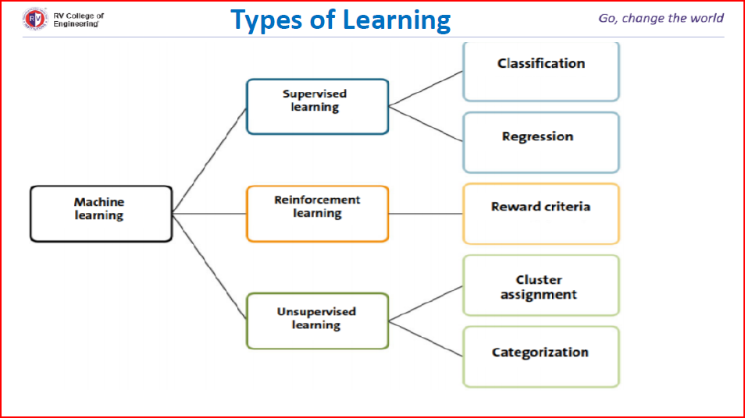

Slide 3
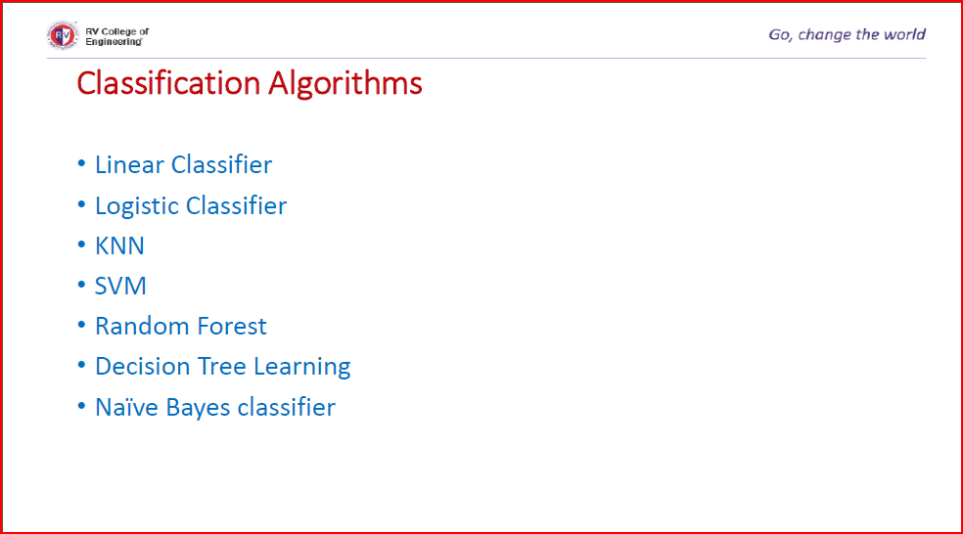

Slide 4
Problem of predicting win/loss in match
Depends on following parameters:
Team won the toss
Number of spinner in a team
Number of wins team had in the tournament
Model accuracy:
It is based on correct/incorrect classification/prediction made by model the accuracy of model is calculated.
99% accuracy means: 99 times out of 100 , what model has predicted is same as what the outcome has been .
99% accuracy may be good in the prediction of match but 1% incorrect prediction may lead to loss of many lives in the field of healthcare.

Slide 5
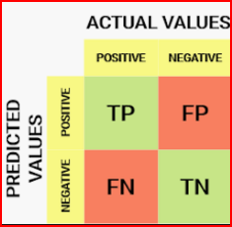


There are four possibilities with regards to cricket match win/loss:
The model predicted win and team won(TP -True positive )
2. The model predicted win and team lost (FP -False positive)
3. The model predicted loss and team won (FN -False negative)
The model predicted loss and team lost (TN-True Negative)
Error rate= (1-model accuracy)
Confusion matrix : A matrix containing correct and incorrect prediction in the form of TPs, TNs, FPs, FNs is known as confusion matrix.
For match win/loss it is 2*2 matrix , classification problem involving three classes the confusion matrix would be 3*3.

Slide 6





The Kappa statistic (or value) is a metric that compares an Observed Accuracy with an Expected Accuracy (random chance). The kappa statistic is used not only to evaluate a single classifier, but also to evaluate classifiers amongst themselves
+

Slide 7
Q1. The confusion matrix of the win/loss prediction of cricket match is given below. Calculate the Kappa value.
 | Actual win | Actual loss
Predicted win | 85 | 4
Predicted loss | 2 | 9
Observed accuracy=(85+9)/(85+9+2+4)=0.94
Expected accuracy=(89*87)/(10000) + (11*13)/(100*100)=0.7886
Kappa value=(0.94-0.7886)/(1-0.7886)=0.7162
Maximum value of kappa=1, represent perfect agreement between prediction and actual values.

Slide 8



Precision: It indicates reliability of a Model In predicting class .How often it predicts the win correctly
Recall : indicates the proportion of correct prediction of positive to the total number of positives.

Slide 9


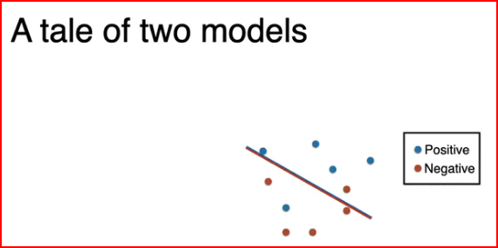
https://youtu.be/z5qA9qZMyw0
Receiver Operating Characteristics(ROC) curve
Model has correctly classified data instances
Model has in-correctly classified data instances
TP | FP
FN | TN

Slide 10
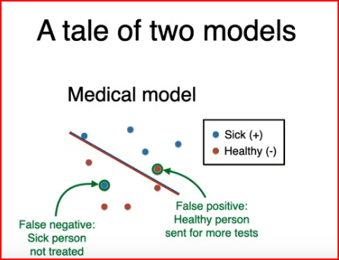
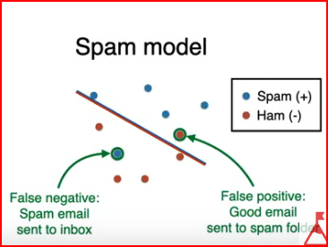

Slide 11
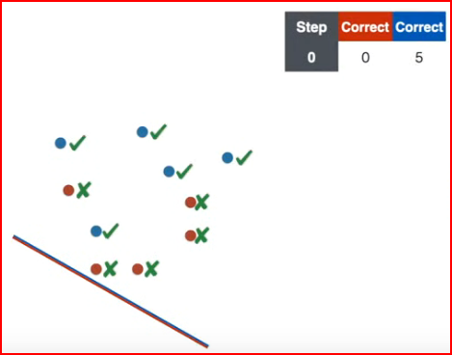
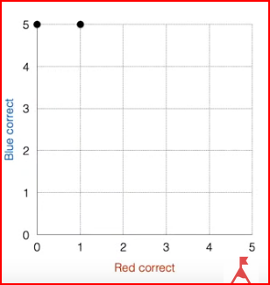
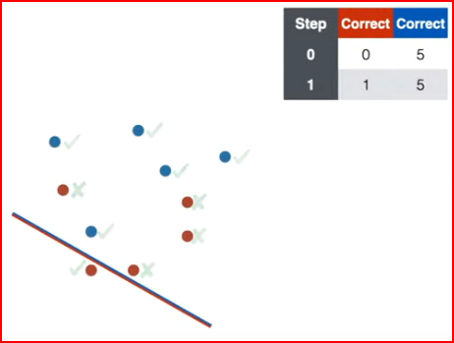

Slide 12
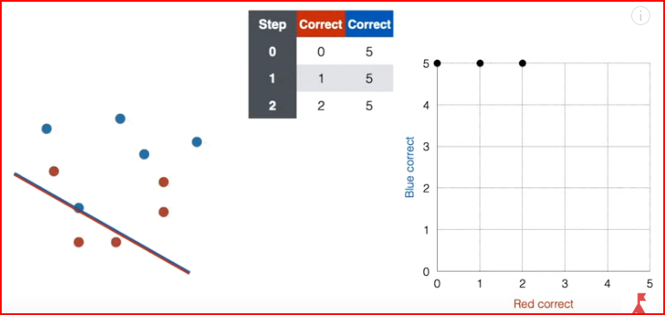
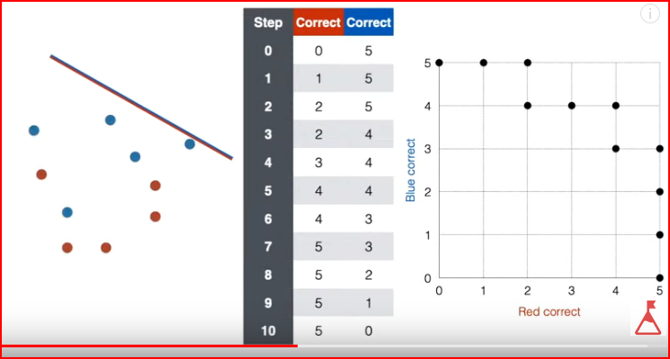

Slide 13
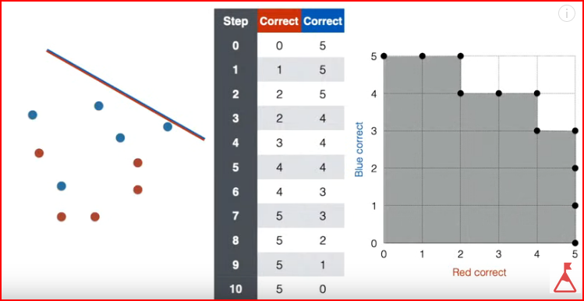

Slide 14
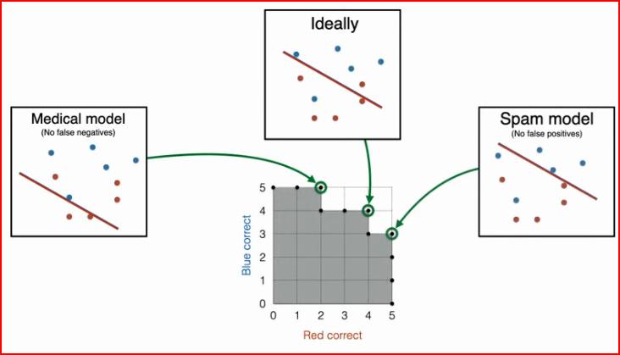
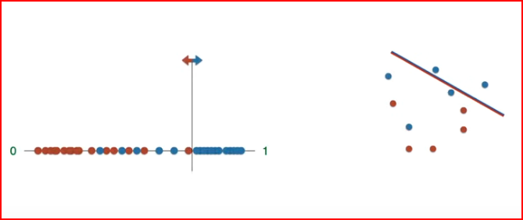

Slide 15
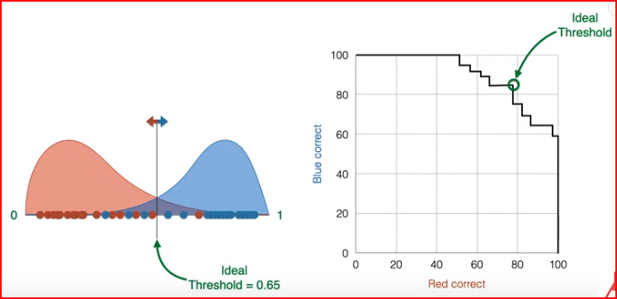

Slide 16
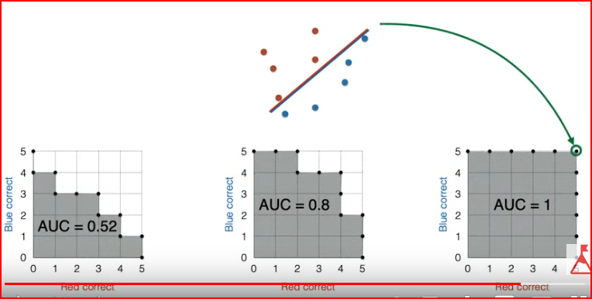
Area under curve : its value ranges from 0 to 1.
AUC of value less than 0.5 indicating that the classifier has no prediction ability.

Slide 17
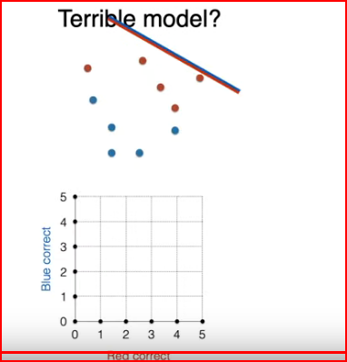
ROC: It helps in visualizing the performance of a classification model.

Slide 18
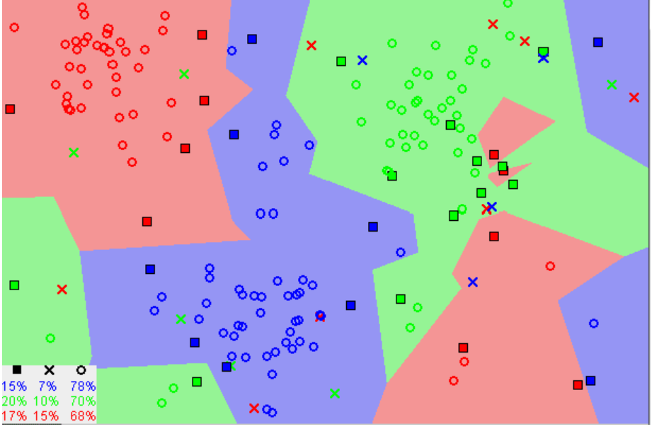
K Nearest Neighbour
assumption is ,similar data points are close to each other. The KNN algorithm hinges on this assumption being true enough for the algorithm to be useful. KNN captures the idea of similarity (sometimes called distance, proximity, or closeness)

Slide 19
The KNN Algorithm
Load the data
Initialize K to your chosen number of neighbors
3. For each example in the data
3.1 Calculate the distance between the query example and the current example from the data.
3.2 Add the distance and the index of the example to an ordered collection
4. Sort the ordered collection of distances and indices from smallest to largest (in ascending order) by the distances
5. Pick the first K entries from the sorted collection
6. Get the labels of the selected K entries
7. If regression, return the mean of the K labels
8. If classification, return the mode of the K labels

Slide 20
Choosing the right value for K
To select the K that’s right for your data, we run the KNN algorithm several times with different values of K and choose the K that reduces the number of errors we encounter while maintaining the algorithm’s ability to accurately make predictions when it’s given data it hasn’t seen before.
Advantages
The algorithm is simple and easy to implement.
There’s no need to build a model, tune several parameters, or make additional assumptions.
The algorithm is versatile. It can be used for classification, regression, and search (as we will see in the next section).
Disadvantages
The algorithm gets significantly slower as the number of examples and/or predictors/independent variables increase.

